Slide 1

Fundamentals of Computer Science and Programming
Unit 3 – Boolean algebra and numeral systems

Slide 2
Outline
Numeral systems
Conversion between numeral systems
Exercise
Binary arithmetic
Exercise
Exercise

Slide 3
Boolean algebra

Slide 4
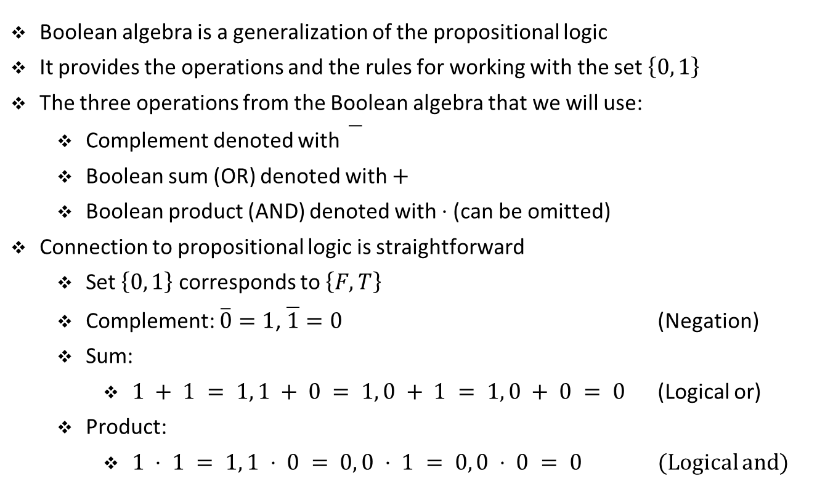
Boolean algebra
Boolean algebra is a generalization of the propositional logic
It provides the operations and the rules for working with the set $\left\{0, 1\right\}$
The three operations from the Boolean algebra that we will use:
Complement denoted with
Boolean sum (OR) denoted with $+$
Boolean product (AND) denoted with ⋅ (can be omitted)
Connection to propositional logic is straightforward
Set $\left\{0, 1\right\}$ corresponds to $\left\{F, T\right\}$
Complement: $\overline{0}=1$, $\overline{1}=0$ (Negation)
Sum:
$1 + 1 = 1, 1 + 0 = 1, 0 + 1 = 1, 0 + 0 = 0$ (Logical or)
Product:
$1 ⋅ 1 = 1, 1 ⋅ 0 = 0, 0 ⋅ 1 = 0, 0 ⋅ 0 = 0$ (Logical and)

Slide 5
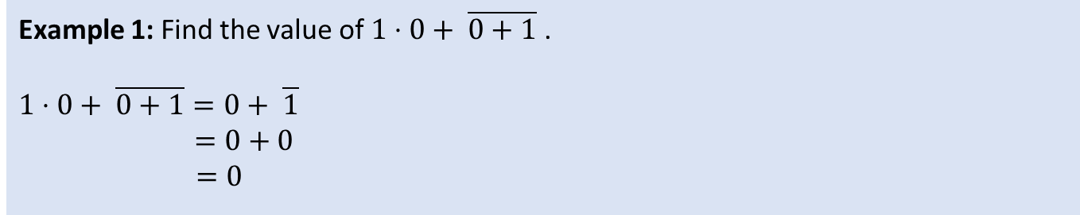
Boolean algebra
Example 1: Find the value of $1⋅0+ \overline{0+1}$ .
$$1⋅0+ \overline{0+1}=0+ \overline{1}$$
$=0+0$
$=0$

Slide 6
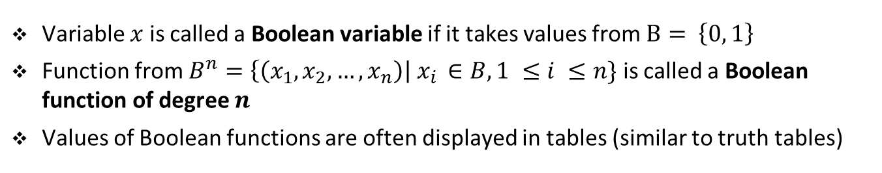
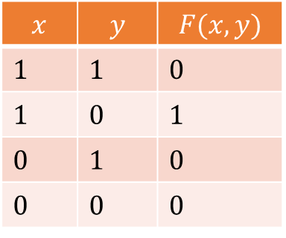
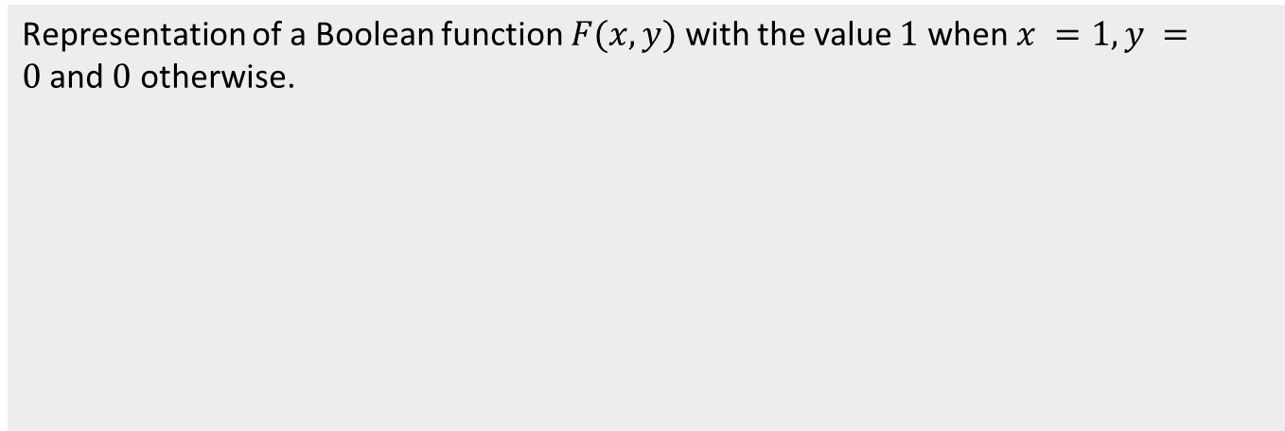
Boolean variables and functions
Variable $x$ is called a Boolean variable if it takes values from $B= \left\{0, 1\right\}$
Function from $B^{n}=\left\{\left(x_{1}, x_{2}, …, x_{n}\right)\right| x_{i }∈B, 1 ≤i ≤n\}$ is called a Boolean function of degree $n$
Values of Boolean functions are often displayed in tables (similar to truth tables)
Representation of a Boolean function $F(x, y)$with the value $1$ when $x =1, y =0$and $0$ otherwise.
$$x$$ | $$y$$ | $$F(x, y)$$
1 | 1 | 0
1 | 0 | 1
0 | 1 | 0
0 | 0 | 0

Slide 7
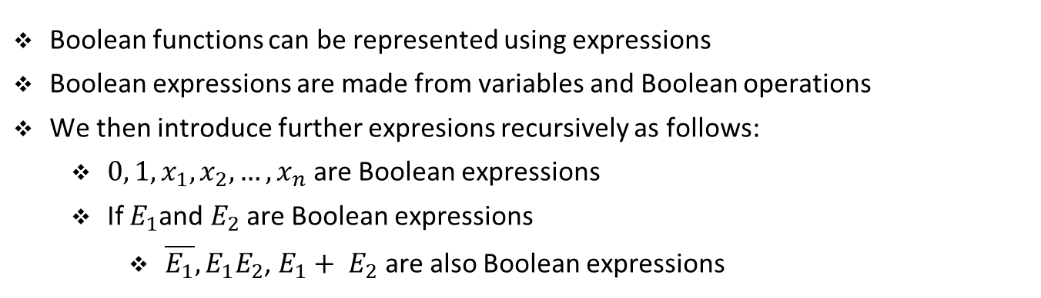
Boolean expressions and functions
Boolean functions can be represented using expressions
Boolean expressions are made from variables and Boolean operations
We then introduce further expresions recursively as follows:
${0, 1, x}_{1}, x_{2}, …, x_{n}$ are Boolean expressions
If $E_{1}$and $E_{2}$ are Boolean expressions
$\overline{E_{1}},E_{1}E_{2}$, $E_{1}+ E_{2}$ are also Boolean expressions

Slide 8
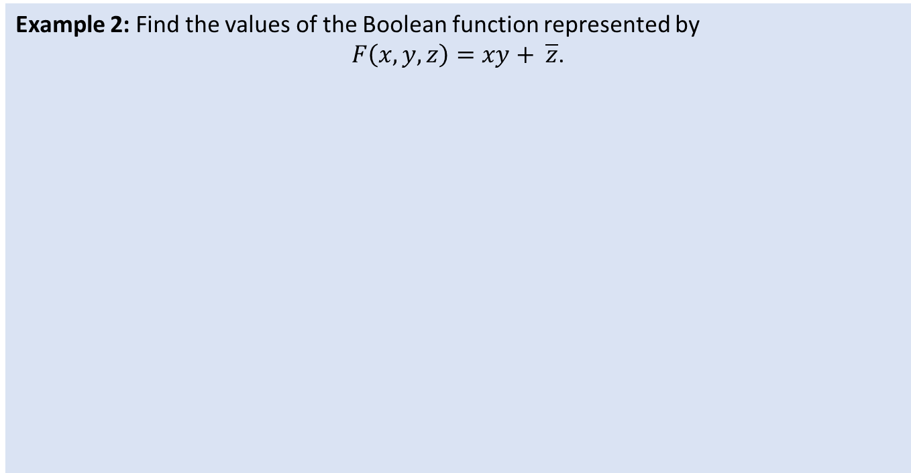
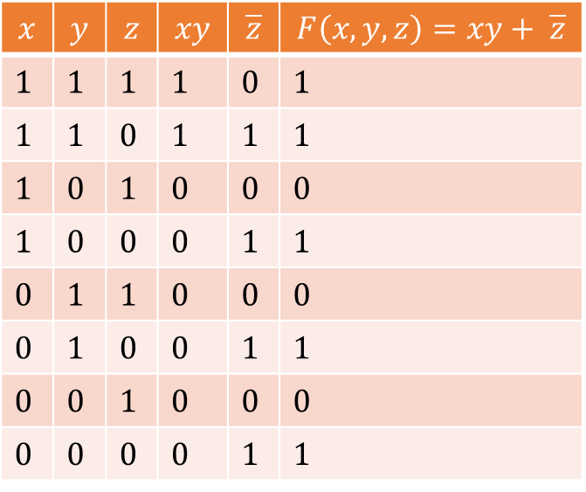
Boolean algebra
Example 2: Find the values of the Boolean function represented by
$F\left(x, y, z\right)=xy+ \overline{z}$.
$$x$$ | $$y$$ | $$z$$ | $$xy$$ | $$\overline{z}$$ | $$F\left(x, y, z\right)=xy+ \overline{z}$$
1 | 1 | 1 | 1 | 0 | 1
1 | 1 | 0 | 1 | 1 | 1
1 | 0 | 1 | 0 | 0 | 0
1 | 0 | 0 | 0 | 1 | 1
0 | 1 | 1 | 0 | 0 | 0
0 | 1 | 0 | 0 | 1 | 1
0 | 0 | 1 | 0 | 0 | 0
0 | 0 | 0 | 0 | 1 | 1

Slide 9
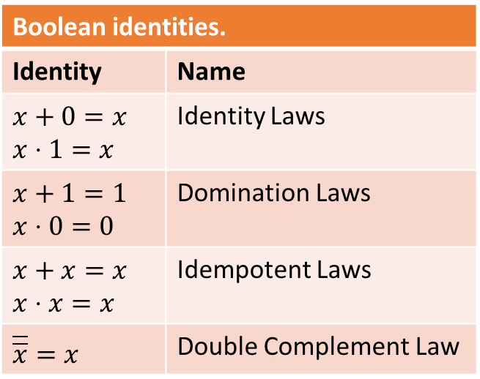
Boolean identities
Logical equivalences from propositional logic translate to Boolean algebra
They are called Boolean identities
Boolean identities.
Identity | Name
$$x+0=x$$ $$x⋅1=x$$ | Identity Laws
$$x+1=1$$ $$x⋅0=0$$ | Domination Laws
$$x+x=x$$ $$x⋅x=x$$ | Idempotent Laws
$$\overline{\overline{x}}=x$$ | Double Complement Law

Slide 10
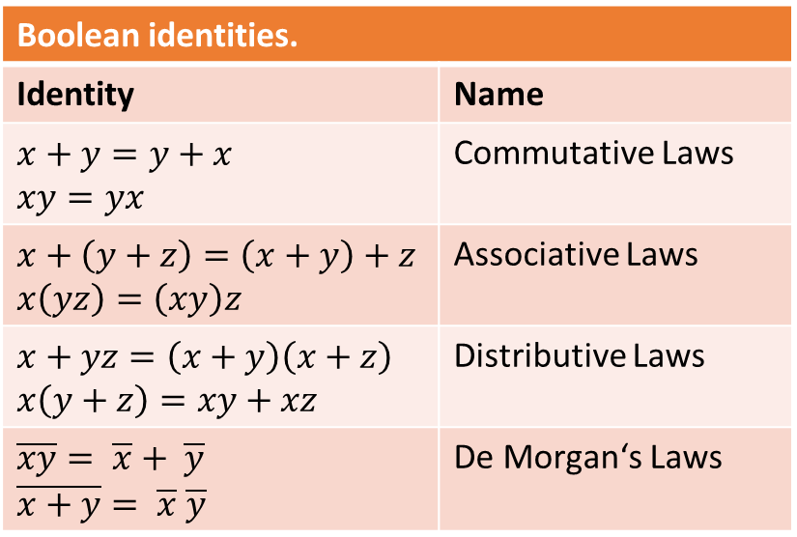
Boolean identities
Boolean identities.
Identity | Name
$$x+y=y+x$$ $$xy=yx$$ | Commutative Laws
$$x+\left(y+z\right)=\left(x+y\right)+z$$ $$x\left(yz\right)=\left(xy\right)z$$ | Associative Laws
$$x+yz=\left(x+y\right)\left(x+z\right)$$ $$x\left(y+z\right)=xy+xz$$ | Distributive Laws
$$\overline{xy}= \overline{x}+ \overline{y}$$ $$\overline{x+y}= \overline{x} \overline{y}$$ | De Morgan‘s Laws

Slide 11
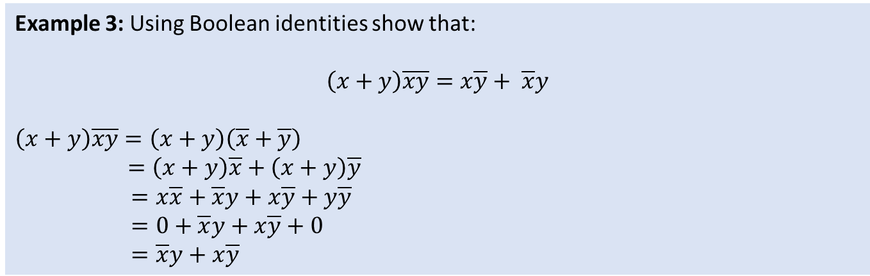
Boolean algebra
Example 3: Using Boolean identities show that:
$$\left(x+y\right)\overline{xy}=x\overline{y}+ \overline{x}y$$
$$\left(x+y\right)\overline{xy}=\left(x+y\right)\left(\overline{x}+\overline{y}\right)$$
$=\left(x+y\right)\overline{x}+\left(x+y\right)\overline{y}$
$=x\overline{x}+\overline{x}y+x\overline{y}+y\overline{y}$
$=0+\overline{x}y+x\overline{y}+0$
$=\overline{x}y+x\overline{y}$

Slide 12
Exercise

Slide 13
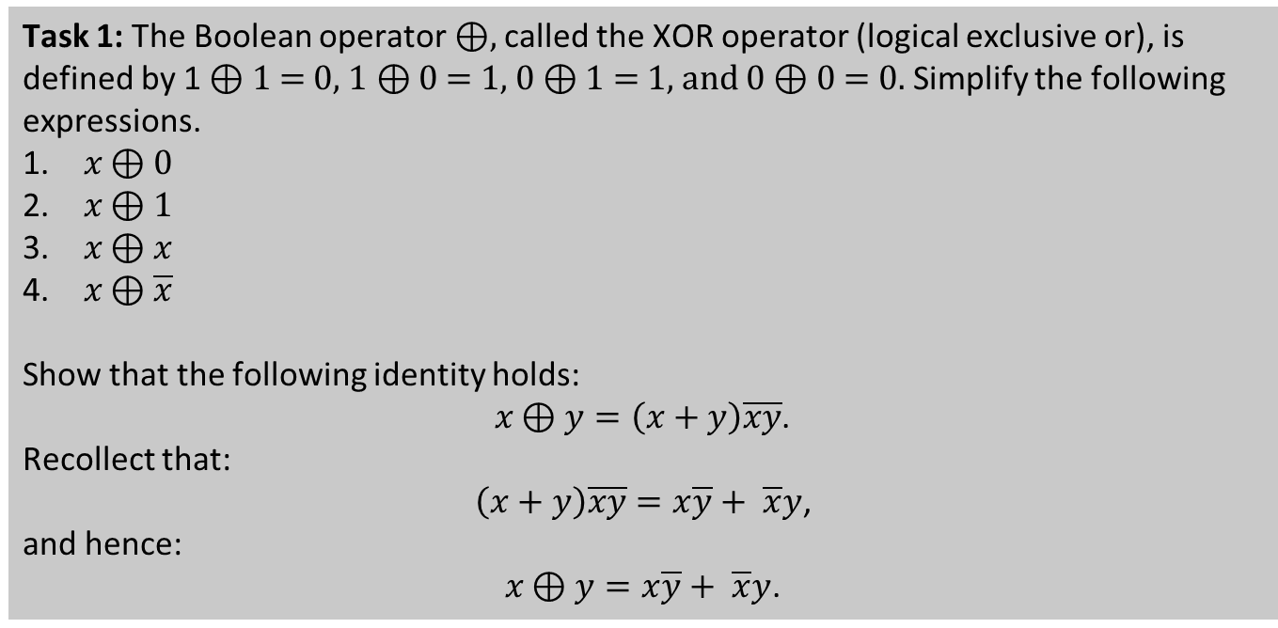
Student task
Task 1: The Boolean operator ⊕, called the XOR operator (logical exclusive or), is defined by 1 ⊕ 1 = 0, 1 ⊕ 0 = 1, 0 ⊕ 1 = 1, and 0 ⊕ 0 = 0. Simplify the following expressions.
$x \text{⊕}\text{ 0}$
$x \text{⊕}\text{ 1}$
$x \text{⊕} x$
$x \text{⊕} \overline{x}$
Show that the following identity holds:
$x \text{⊕} y=\left(x+y\right)\overline{xy}$.
Recollect that:
$\left(x+y\right)\overline{xy}=x\overline{y}+ \overline{x}y$,
and hence:
$x \text{⊕} y=x\overline{y}+ \overline{x}y$.

Slide 14
Numeral systems

Slide 15





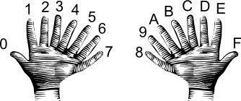
Numeral systems
Decimal system
Binary system
Octal system
Hexadecimal system
Arbitrary system
https://en.wikipedia.org/wiki/File:Hand_INC.svg
https://commons.wikimedia.org/wiki/File:Led_light_bulb_-_led_lamp_2.png
http://pngimg.com/download/29445
https://www.i-programmer.info/images/stories/BabBag/hex/hand16.png
?

Slide 16
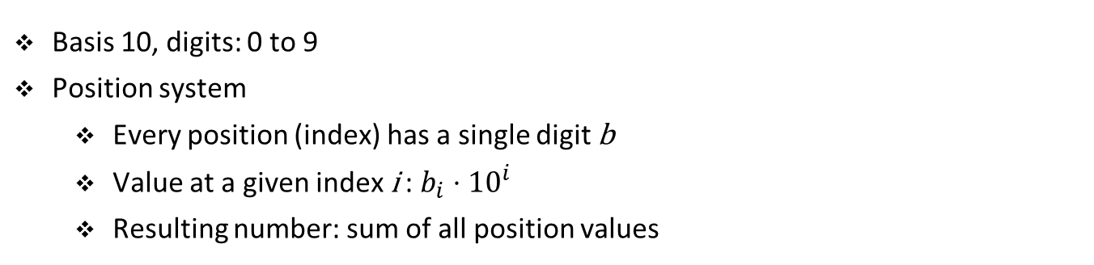
Decimal system
Basis 10, digits: 0 to 9
Position system
Every position (index) has a single digit b
Value at a given index i : $b_{i}⋅{10}^{i}$
Resulting number: sum of all position values

Slide 17
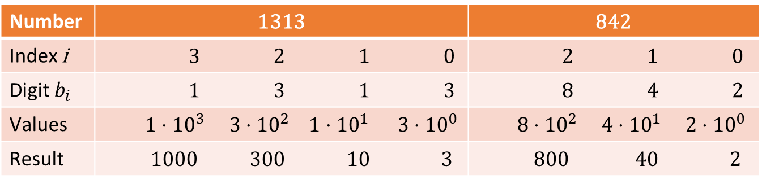
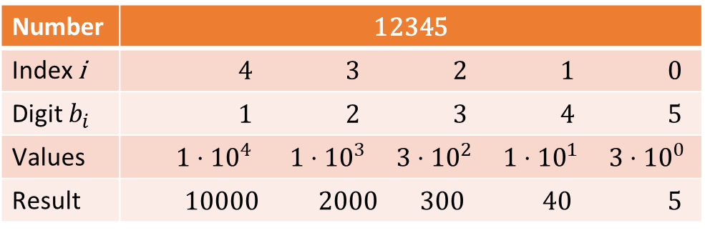
Decimal system
Example 1: Numbers in decimal system.
Number | 1313 | 842
Index i | 3 2 1 0 | 2 1 0
Digit $b_{i}$ | 1 3 1 3 | 8 4 2
Values | $1⋅{10}^{3} 3⋅{10}^{2} 1⋅{10}^{1} 3⋅{10}^{0}$ | $8⋅{10}^{2} 4⋅{10}^{1} 2⋅{10}^{0}$
Result | 1000 300 10 3 | 800 40 2
Number | 12345
Index i | 4 3 2 1 0
Digit $b_{i}$ | 1 2 3 4 5
Values | $1⋅{10}^{4}$ $1⋅{10}^{3} 3⋅{10}^{2} 1⋅{10}^{1} 3⋅{10}^{0}$
Result | 10000 2000 300 40 5

Slide 18
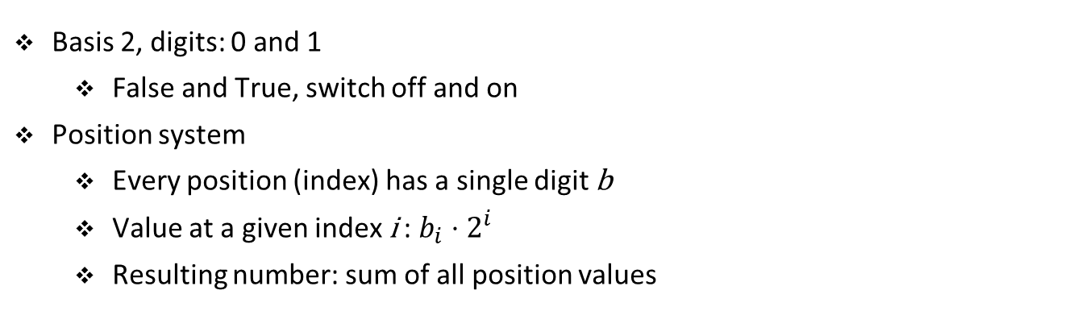
Binary system
Basis 2, digits: 0 and 1
False and True, switch off and on
Position system
Every position (index) has a single digit b
Value at a given index i : $b_{i}⋅2^{i}$
Resulting number: sum of all position values

Slide 19
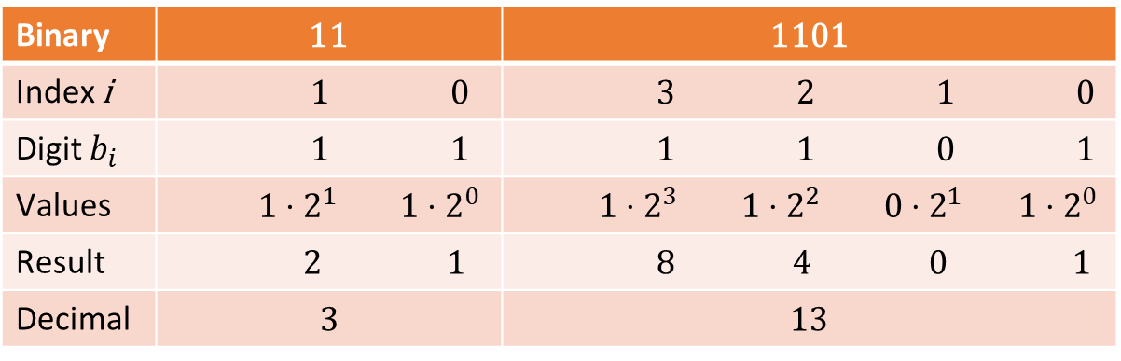
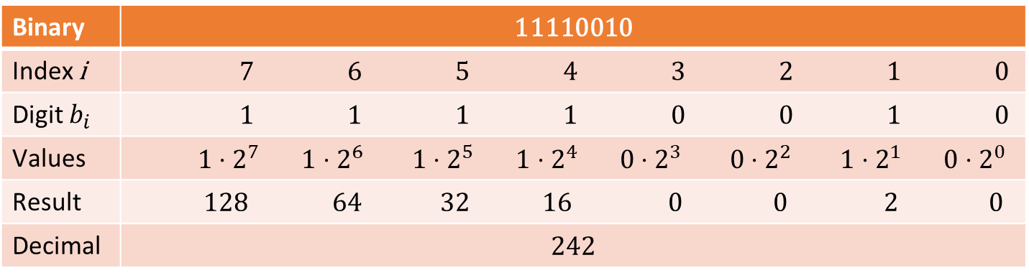
Binary system
Example 2: Numbers in binary system.
Binary | 11 | 1101
Index i | 1 0 | 3 2 1 0
Digit $b_{i}$ | 1 1 | 1 1 0 1
Values | $1⋅2^{1} 1⋅2^{0}$ | $1⋅2^{3} 1⋅2^{2} 0⋅2^{1} 1⋅2^{0}$
Result | 2 1 | 8 4 0 1
Decimal | 3 | 13
Binary | 11110010
Index i | 7 6 5 4 3 2 1 0
Digit $b_{i}$ | 1 1 1 1 0 0 1 0
Values | $$1⋅2^{7} 1⋅2^{6} 1⋅2^{5} 1⋅2^{4} 0⋅2^{3} 0⋅2^{2} 1⋅2^{1} 0⋅2^{0}$$
Result | 128 64 32 16 0 0 2 0
Decimal | 242

Slide 20
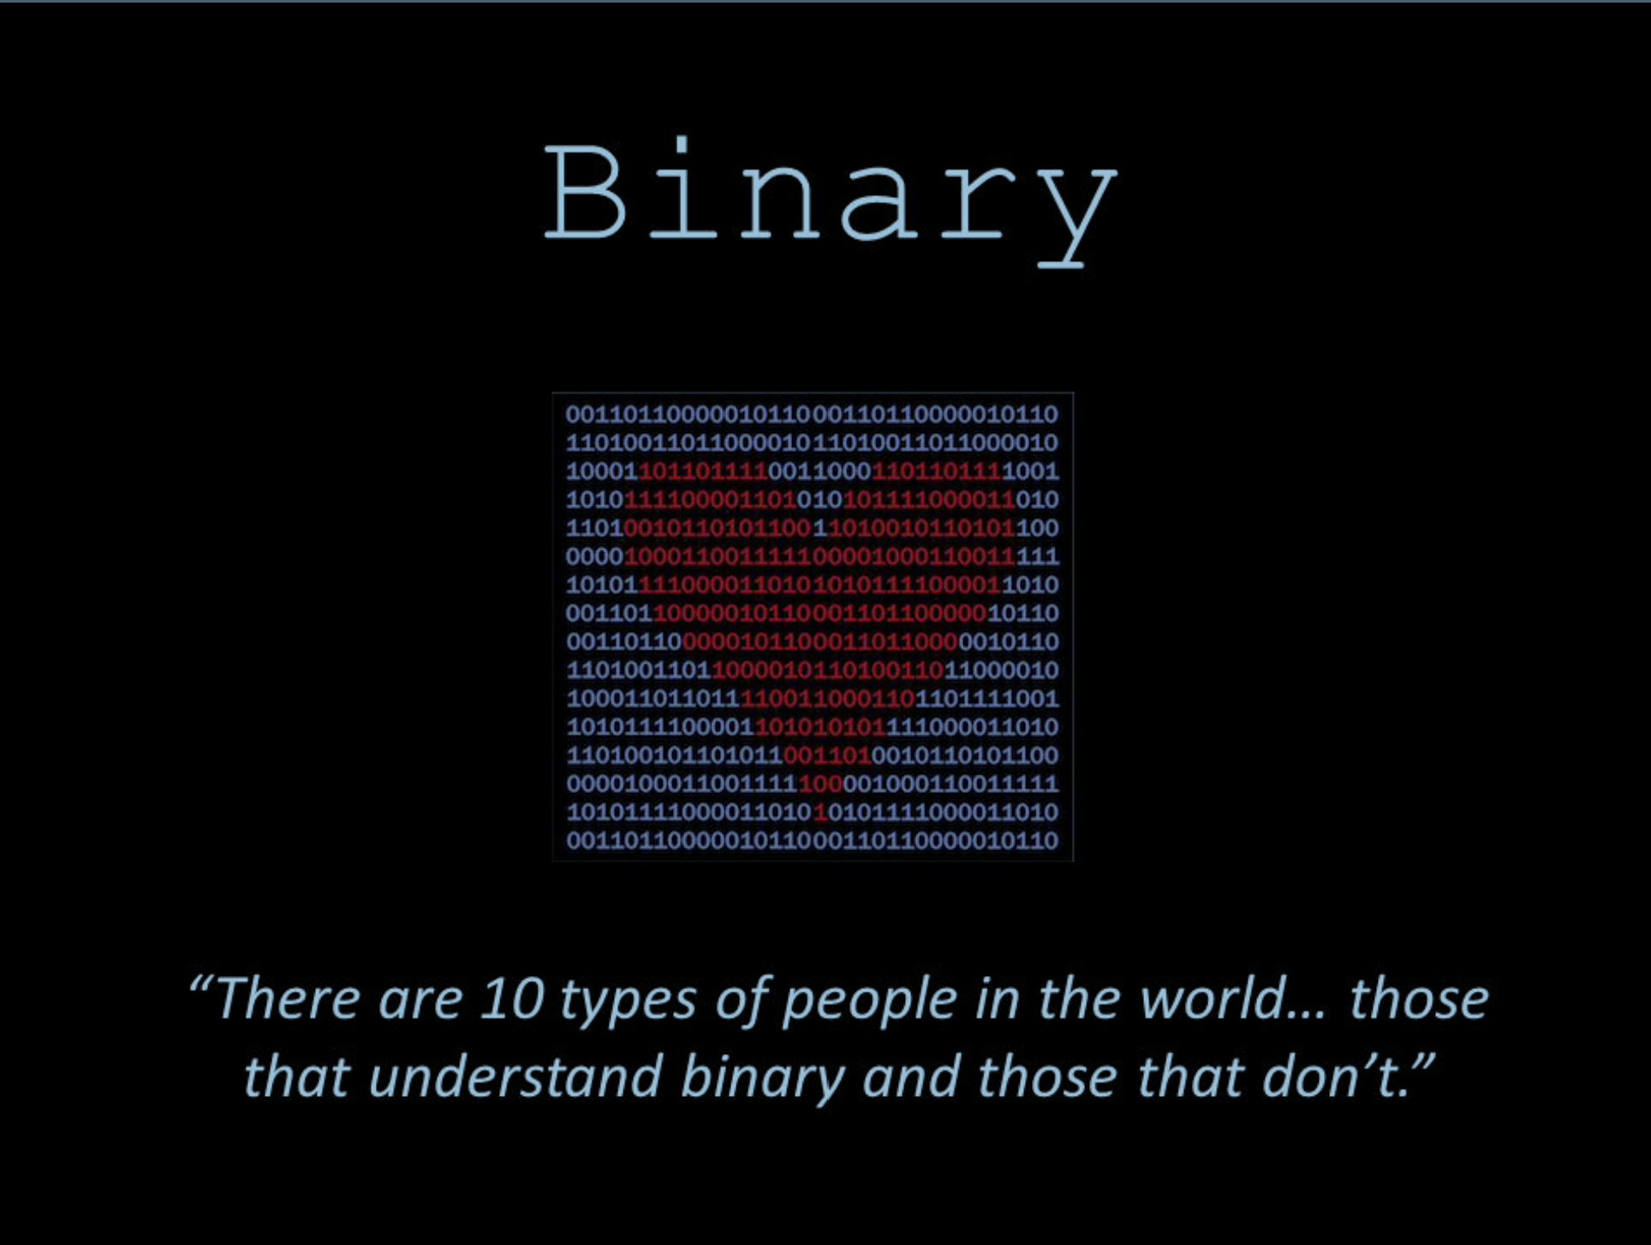
Counting in powers of two
Source: slideplayer.com

Slide 21
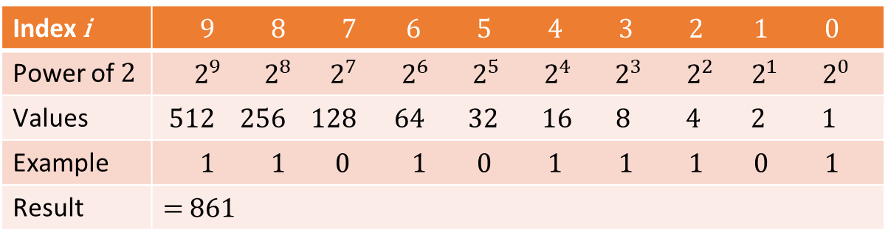
Counting in powers of two
Important concept: counting in powers of two
Collection of 8 positions (0 - 7): 1 Byte
Index i | 9 8 7 6 5 4 3 2 1 0
Power of 2 | $2^{9} 2^{8 } 2^{7} 2^{6} 2^{5} 2^{4} 2^{3} 2^{2} 2^{1}{ 2}^{0}$
Values | $512 256 128 64 32 16 8 4 2 1$
Example | 1 1 0 1 0 1 1 1 0 1
Result | = 861

Slide 22
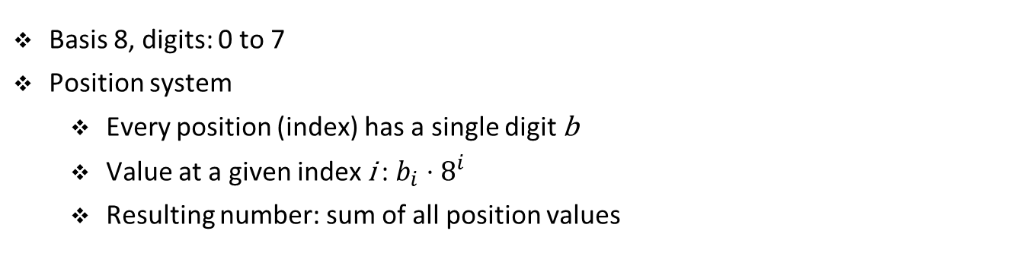
Octal system
Basis 8, digits: 0 to 7
Position system
Every position (index) has a single digit b
Value at a given index i : $b_{i}⋅8^{i}$
Resulting number: sum of all position values

Slide 23
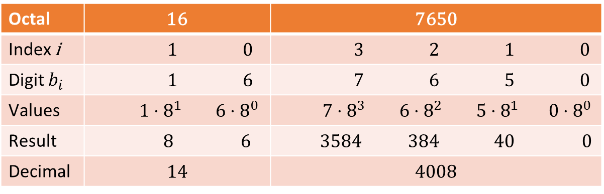
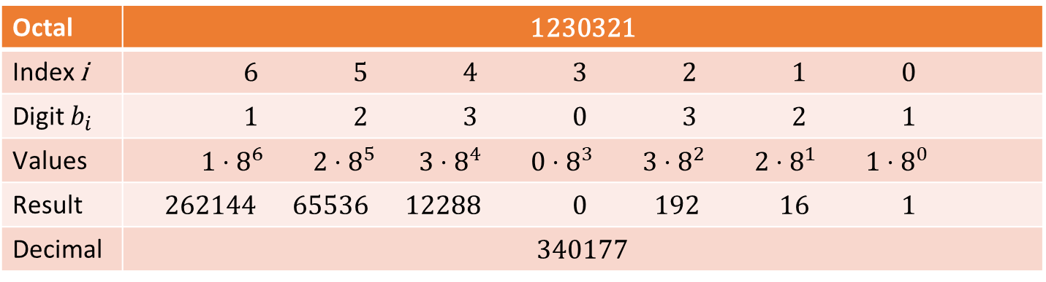
Octal system
Example 3: Numbers in octal system.
Octal | 16 | 7650
Index i | 1 0 | 3 2 1 0
Digit $b_{i}$ | 1 6 | 7 6 5 0
Values | $1⋅8^{1} 6⋅8^{0}$ | $7⋅8^{3} 6⋅8^{2} 5⋅8^{1} 0⋅8^{0}$
Result | 8 6 | 3584 384 40 0
Decimal | 14 | 4008
Octal | 1230321
Index i | 6 5 4 3 2 1 0
Digit $b_{i}$ | 1 2 3 0 3 2 1
Values | $$1⋅8^{6} 2⋅8^{5} 3⋅8^{4} 0⋅8^{3} 3⋅8^{2} 2⋅8^{1} 1⋅8^{0}$$
Result | 262144 65536 12288 0 192 16 1
Decimal | 340177

Slide 24
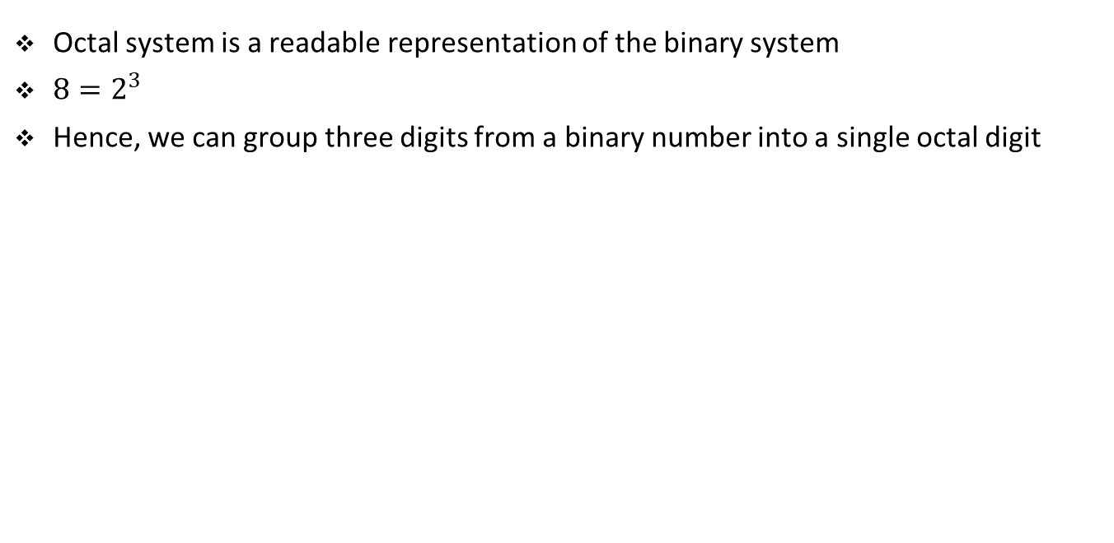
Octal system
Octal system is a readable representation of the binary system
${8=2}^{3}$
Hence, we can group three digits from a binary number into a single octal digit
Binary | 11 | 1101 | 11110010
Groups | 11 | 1 101 | 11 110 010
Value | 3 | 1 5 | 3 6 2
Octal | 3 | 15 | 362
Decimal | 3 | 13 | 242
Binary | 100010100010100010
Groups | 100 010 100 010 100 010
Value | 4 2 4 2 4 2
Octal | 424242
Decimal | 141474

Slide 25
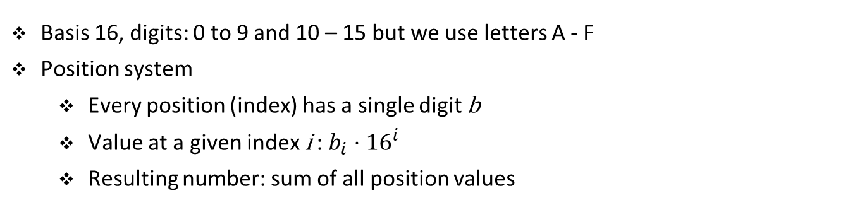
Hexadecimal system
Basis 16, digits: 0 to 9 and 10 – 15 but we use letters A - F
Position system
Every position (index) has a single digit b
Value at a given index i : $b_{i}⋅{16}^{i}$
Resulting number: sum of all position values

Slide 26
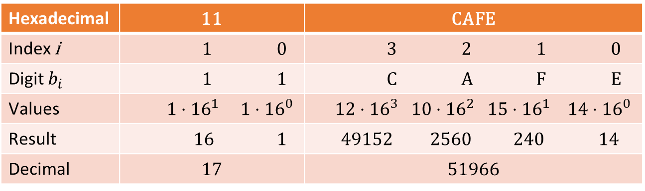
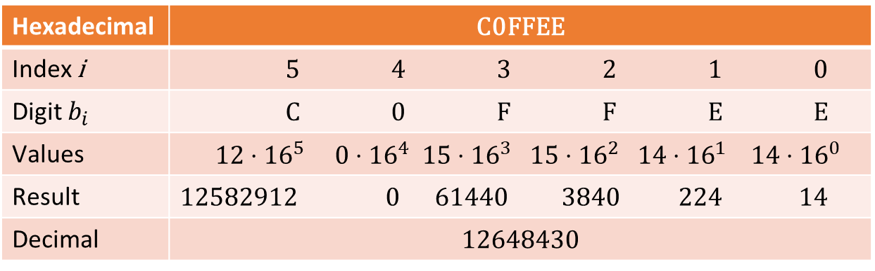
Hexadecimal system
Example 3: Numbers in hexadecimal system.
Hexadecimal | 11 | CAFE
Index i | 1 0 | 3 2 1 0
Digit $b_{i}$ | 1 1 | C A F E
Values | $1⋅{16}^{1} 1⋅{16}^{0}$ | $12⋅{16}^{3} 10⋅{16}^{2} 15⋅{16}^{1} 14⋅{16}^{0}$
Result | 16 1 | 49152 2560 240 14
Decimal | 17 | 51966
Hexadecimal | C0FFEE
Index i | 5 4 3 2 1 0
Digit $b_{i}$ | C 0 F F E E
Values | $$12⋅{16}^{5} 0⋅{16}^{4} 15⋅{16}^{3} 15⋅{16}^{2} 14⋅{16}^{1} 14⋅{16}^{0}$$
Result | 12582912 0 61440 3840 224 14
Decimal | 12648430

Slide 27
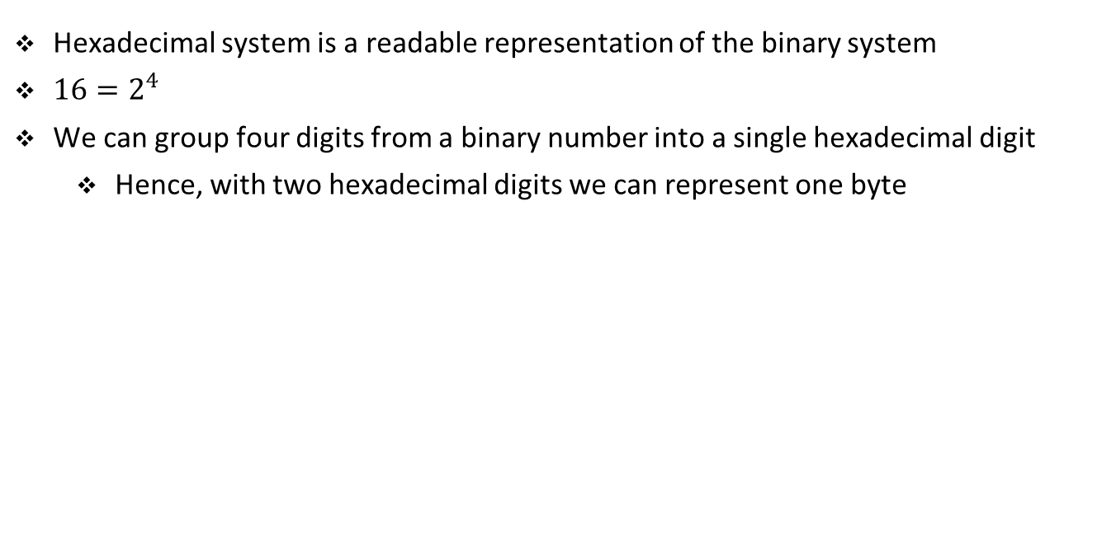
Hexadecimal system
Hexadecimal system is a readable representation of the binary system
${16=2}^{4}$
We can group four digits from a binary number into a single hexadecimal digit
Hence, with two hexadecimal digits we can represent one byte
Binary | 1101 | 11110010 | 100010100010100010
Groups | 1101 | 1111 0010 | 10 0010 1000 1010 0010
Value | D | F 2 | 2 2 8 A 2
Hexa | D | F2 | 228A2
Decimal | 13 | 242 | 141474

Slide 28
Numbers table
Binary | Octal | Decimal | Hexadecimal
0 | 0 | 0 | 0
1 | 1 | 1 | 1
10 | 2 | 2 | 2
11 | 3 | 3 | 3
100 | 4 | 4 | 4
101 | 5 | 5 | 5
110 | 6 | 6 | 6
111 | 7 | 7 | 7
1000 | 10 | 8 | 8
1001 | 11 | 9 | 9
1010 | 12 | 10 | A
1011 | 13 | 11 | B
1100 | 14 | 12 | C
1101 | 15 | 13 | D
1110 | 16 | 14 | E
1111 | 17 | 15 | F

Slide 29
Numbers table
Binary | Octal | Decimal | Hexadecimal
10000 | 20 | 16 | 10
10001 | 21 | 17 | 11
10010 | 22 | 18 | 12
10011 | 23 | 19 | 13
10100 | 24 | 20 | 14
10101 | 25 | 21 | 15
10110 | 26 | 22 | 16
10111 | 27 | 23 | 17
11000 | 30 | 24 | 18
11001 | 31 | 25 | 19
11010 | 32 | 26 | 1A
11011 | 33 | 27 | 1B
11100 | 34 | 28 | 1C
11101 | 35 | 29 | 1D
11110 | 36 | 30 | 1E
11111 | 37 | 31 | 1F

Slide 30
Conversion between numeral systems

Slide 31
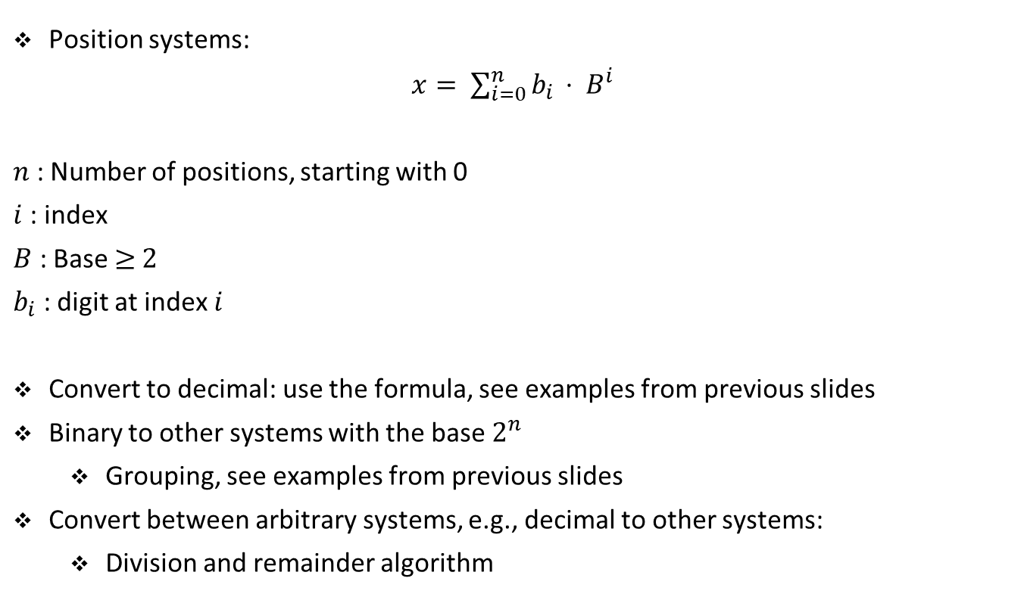
Numeral systems conversions
Position systems:
$x= \sum_{i=0}^{n}{b_{i }}⋅ B^{i}$
$n$ : Number of positions, starting with 0
$i$: index
$B$ : Base ≥ 2
$b_{i}$ : digit at index $i$
Convert to decimal: use the formula, see examples from previous slides
Binary to other systems with the base $2^{n}$
Grouping, see examples from previous slides
Convert between arbitrary systems, e.g., decimal to other systems:
Division and remainder algorithm

Slide 32
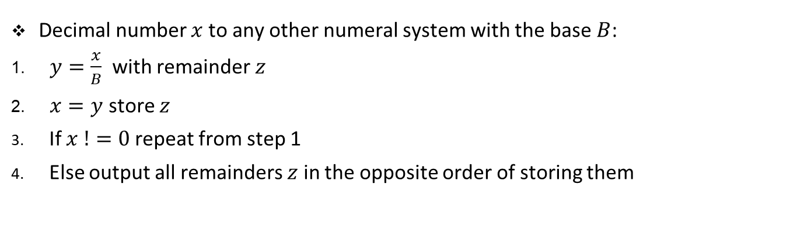
Division and remainder
Decimal number $x$to any other numeral system with the base $B$:
$y=\frac{x}{B}$ with remainder $z$
$x=y$ store $z$
If $x !=0$repeat from step 1
Else output all remainders $z$ in the opposite order of storing them

Slide 33
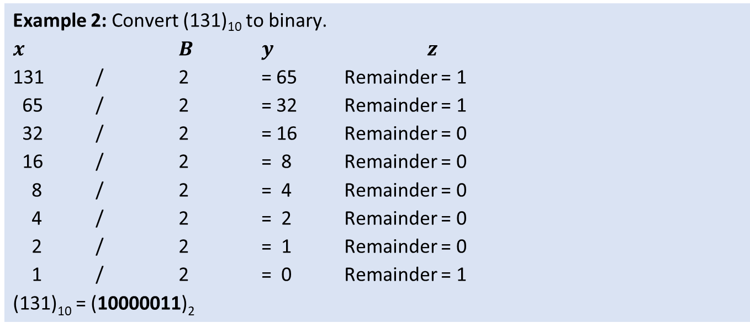
Division and remainder
Example 2: Convert (131)₁₀ to binary.
$x$ $B$ $y$ $z$
131 / 2 = 65 Remainder = 1
65 / 2 = 32 Remainder = 1
32 / 2 = 16 Remainder = 0
16 / 2 = 8 Remainder = 0
8 / 2 = 4 Remainder = 0
4 / 2 = 2 Remainder = 0
2 / 2 = 1 Remainder = 0
1 / 2 = 0 Remainder = 1
(131)₁₀ = (10000011)₂

Slide 34
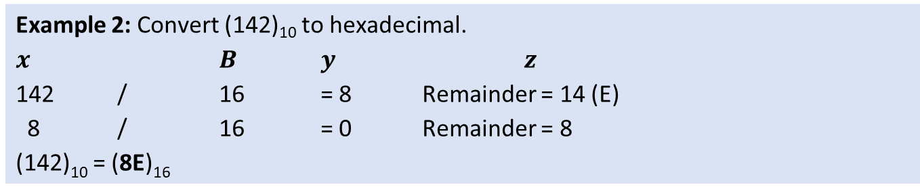
Division and remainder
Example 2: Convert (142)₁₀ to hexadecimal.
$x$ $B$ $y$ $z$
142 / 16 = 8 Remainder = 14 (E)
8 / 16 = 0 Remainder = 8
(142)₁₀ = (8E)₁₆

Slide 35
Exercise

Slide 36
Student task
Task 2: Convert the numbers between numeral systems.
(245)₁₀ to binary, octal, and hexadecimal system.
(14D)₁₆ to binary, octal, and hexadecimal system.
(231)₈ to binary, decimal, and hexadecimal system.
(1001100)₂ to octal, decimal, and hexadecimal system.

Slide 37
Binary arithmetic

Slide 38
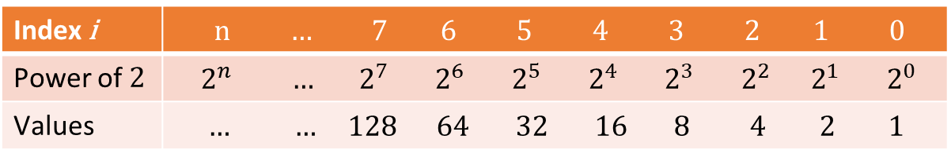
Arithmetic operations with binary numbers
Basic arithmetic operations
Addition
Negative numbers
Subtraction
Multiplication and division can be implemented by repeated addition/subtraction
Least significant bit (LSB)
Right most (last) position
Most significant bit (MSB)
Left most (first) position
Index i | n … 7 6 5 4 3 2 1 0
Power of 2 | $${ 2}^{n} { … 2}^{7} 2^{6} 2^{5} 2^{4} 2^{3} 2^{2} 2^{1}{ 2}^{0}$$
Values | $… … 128 64 32 16 8 4 2 1$

Slide 39
Addition of binary numbers
Basic operation
+ | First number
 | Second number
c | Carry
= | Result
0 + 0 = 0
+ | 0 | 0
 | 0 | 0
c | 0 | 0
= | 0 | 0
1 + 0 = 1
+ | 0 | 1
 | 0 | 0
c | 0 | 0
= | 0 | 1
0 + 1 = 1
+ | 0 | 0
 | 0 | 1
c | 0 | 0
= | 0 | 1
1 + 1 = (0, c) = 10
+ | 0 | 1
 | 0 | 1
c | 1 | 0
= | 1 | 0
1+1+1=(1, c)=11
+ | 0 | 1
 | 0 | 1
c | 1 | 1
= | 1 | 1

Slide 40
Addition of binary numbers
45 + 54 = 99
 | 64 | 32 | 16 | 8 | 4 | 2 | 1 |  | Position value
+ | 0 | 1 | 0 | 1 | 1 | 0 | 1 |  | First number = 45
 | 0 | 1 | 1 | 0 | 1 | 1 | 0 |  | Second number = 54
c | 1 | 1 | 1 | 1 | 0 | 0 | 0 |  | Carry
= | 1 | 1 | 0 | 0 | 0 | 1 | 1 |  | Result = 99
341 + 444 = 785
 | 512 | 256 | 128 | 64 | 32 | 16 | 8 | 4 | 2 | 1 |  | Position value
+ | 0 | 1 | 0 | 1 | 0 | 1 | 0 | 1 | 0 | 1 |  | First number = 341
 | 0 | 1 | 1 | 0 | 1 | 1 | 1 | 1 | 0 | 0 |  | Second number = 444
c | 1 | 1 | 1 | 1 | 1 | 1 | 1 | 0 | 0 | 0 |  | Carry
= | 1 | 1 | 0 | 0 | 0 | 1 | 0 | 0 | 0 | 1 |  | Result = 785

Slide 41
Exercise

Slide 42
Student task
Task 3: Add the numbers in binary numeral system.
25 and 67
34 and 12
112 and 123
200 and 33
x + y = ?
 | 128 | 64 | 32 | 16 | 8 | 4 | 2 | 1 |  | Position value
+ |  |  |  |  |  |  |  |  |  | First number
 |  |  |  |  |  |  |  |  |  | Second number
c |  |  |  |  |  |  |  |  |  | Carry
= |  |  |  |  |  |  |  |  |  | Result = ?

Slide 43
Negative numbers
Representation we used so far
Unsigned number range, which is always positive
To represent negative numbers we convert numbers to their complement
There are several complement conversion methods
We will learn Two’s Complement:
Complement all bits and add 1
We will reserve MSB for the sign of the number:
MSB is 1 for negative numbers and 0 for positive numbers

Slide 44
Negative numbers
Example 8: Find two‘s complement of 45 represented with one byte.
0 | 0 | 1 | 0 | 1 | 1 | 0 | 1 |  | = 45
1 | 1 | 0 | 1 | 0 | 0 | 1 | 0 |  | Ones‘ complement of 45
0 | 0 | 0 | 0 | 0 | 0 | 0 | 1 |  | +1
0 | 0 | 0 | 0 | 0 | 0 | 0 | 0 |  | Carry
1 | 1 | 0 | 1 | 0 | 0 | 1 | 1 |  | Result = -45

Slide 45
Negative numbers
Complement is used to complete the number range
Positive number + its two‘s complement (negative number) = 0
Example 8: Adding a number with its two‘s complement results in zero.
45 + (-45) = 0
+ |  | 0 | 0 | 1 | 0 | 1 | 1 | 0 | 1 |  | = 45
 |  | 1 | 1 | 0 | 1 | 0 | 0 | 1 | 1 |  | = -45
c | 1 | 1 | 1 | 1 | 1 | 1 | 1 | 1 | 0 |  | Carry
= | 1 | 0 | 0 | 0 | 0 | 0 | 0 | 0 | 0 |  | Result = 0

Slide 46
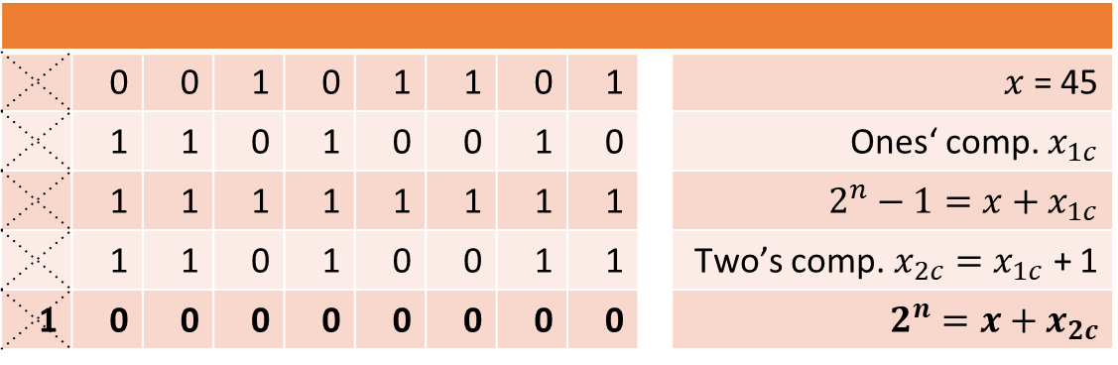
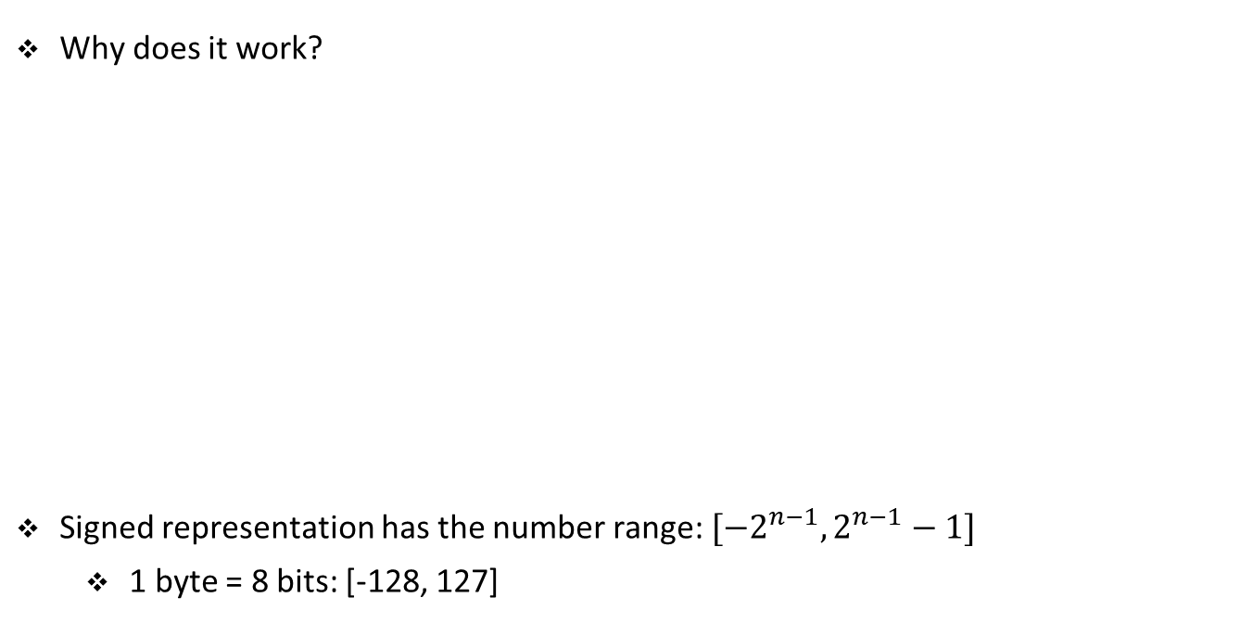
Ones’ and two’s complement
Why does it work?
Signed representation has the number range: ${[−2}^{n−1}, 2^{n−1}−1]$
1 byte = 8 bits: [-128, 127]
Example 8: Theory behind ones‘ and two‘s complement.
 | 0 | 0 | 1 | 0 | 1 | 1 | 0 | 1 |  | $x$ = 45
 | 1 | 1 | 0 | 1 | 0 | 0 | 1 | 0 |  | Ones‘ comp. $x_{1c}$
 | 1 | 1 | 1 | 1 | 1 | 1 | 1 | 1 |  | $2^{n}−1=x+x_{1c}$
 | 1 | 1 | 0 | 1 | 0 | 0 | 1 | 1 |  | Two’s comp. $x_{2c}=x_{1c}$ + 1
1 | 0 | 0 | 0 | 0 | 0 | 0 | 0 | 0 |  | $$2^{n}=x+x_{2c}$$

Slide 47
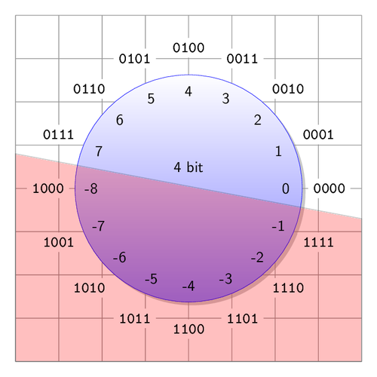
Signed binary representation
0 | 1 | 1 | 0 |  | = 6
1 | 0 | 0 | 1 |  | Ones‘ comp. of 45
0 | 0 | 0 | 1 |  | +1
0 | 0 | 1 | 0 |  | Carry
1 | 0 | 1 | 0 |  | Result = -6
6 + (-6) = 0
+ |  | 0 | 1 | 1 | 0 |  | = 6
 |  | 1 | 0 | 1 | 0 |  | = -6
c | 1 | 1 | 1 | 0 | 0 |  | Carry
= | 1 | 0 | 0 | 0 | 0 |  | Result = 0
https://texample.net/media/tikz/examples/PNG/complement.png

Slide 48
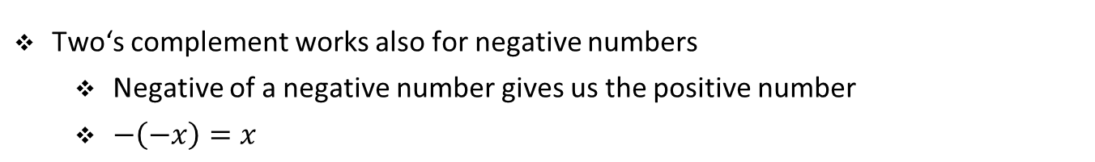
Negatives of negative numbers
Two‘s complement works also for negative numbers
Negative of a negative number gives us the positive number
$−\left(−x\right)=x$
Example 8: Find two‘s complement of -45 represented with one byte.
1 | 1 | 0 | 1 | 0 | 0 | 1 | 1 |  | = -45
0 | 0 | 1 | 0 | 1 | 1 | 0 | 0 |  | Ones‘ complement of -45
0 | 0 | 0 | 0 | 0 | 0 | 0 | 1 |  | +1
0 | 0 | 0 | 0 | 0 | 0 | 0 | 0 |  | Carry
0 | 0 | 1 | 0 | 1 | 1 | 0 | 1 |  | Result = 45

Slide 49
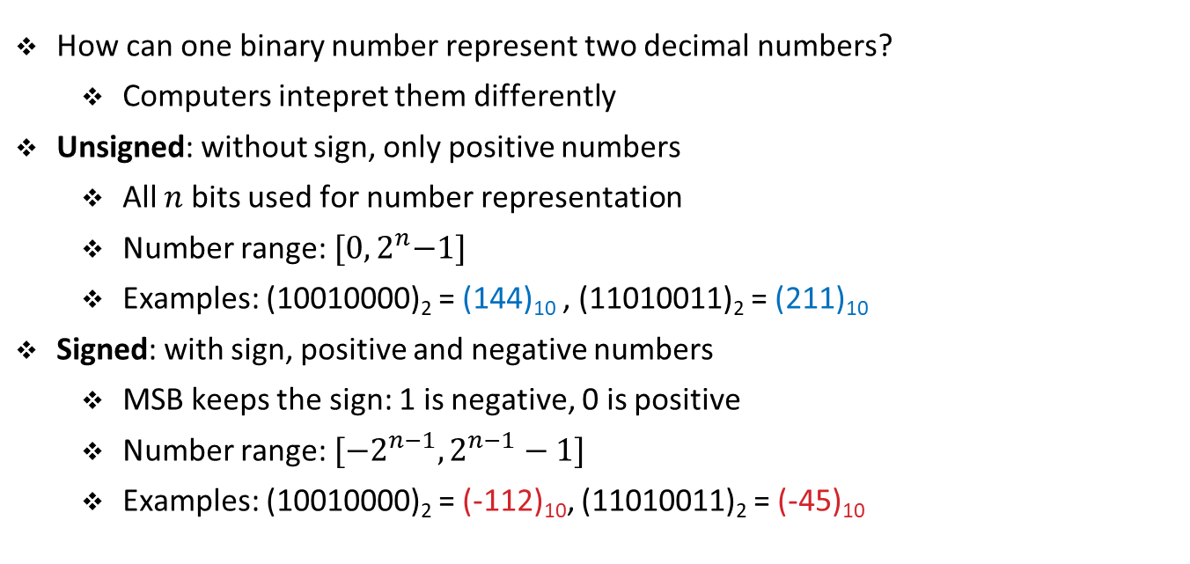
Unsigned vs signed representation
How can one binary number represent two decimal numbers?
Computers intepret them differently
Unsigned: without sign, only positive numbers
All $n$bits used for number representation
Number range: ${[0, 2}^{n}−1]$
Examples: (10010000)₂ = (144)₁₀ , (11010011)₂ = (211)₁₀
Signed: with sign, positive and negative numbers
MSB keeps the sign: 1 is negative, 0 is positive
Number range: ${[−2}^{n−1}, 2^{n−1}−1]$
Examples: (10010000)₂ = (-112)₁₀, (11010011)₂ = (-45)₁₀

Slide 50
Importance of number ranges
-29 + (-13) = -42
+ |  | 1 | 1 | 1 | 0 | 0 | 0 | 1 | 1 |  | = -29
 |  | 1 | 1 | 1 | 1 | 0 | 0 | 1 | 1 |  | = -13
c | 1 | 1 | 1 | 0 | 0 | 0 | 1 | 1 | 0 |  | Carry
= | 1 | 1 | 1 | 0 | 1 | 0 | 1 | 1 | 0 |  | Result = -42
-68 + (-101) = -169
+ |  | 1 | 0 | 1 | 1 | 1 | 1 | 0 | 0 |  | = -68
 |  | 1 | 0 | 0 | 1 | 1 | 0 | 1 | 1 |  | = -101
c | 1 | 0 | 1 | 1 | 1 | 0 | 0 | 0 | 0 |  | Carry
= | 1 | 0 | 1 | 0 | 1 | 0 | 1 | 1 | 1 |  | Result = 87
Wrong result because we are outside of the range: [-128, 127]

Slide 51
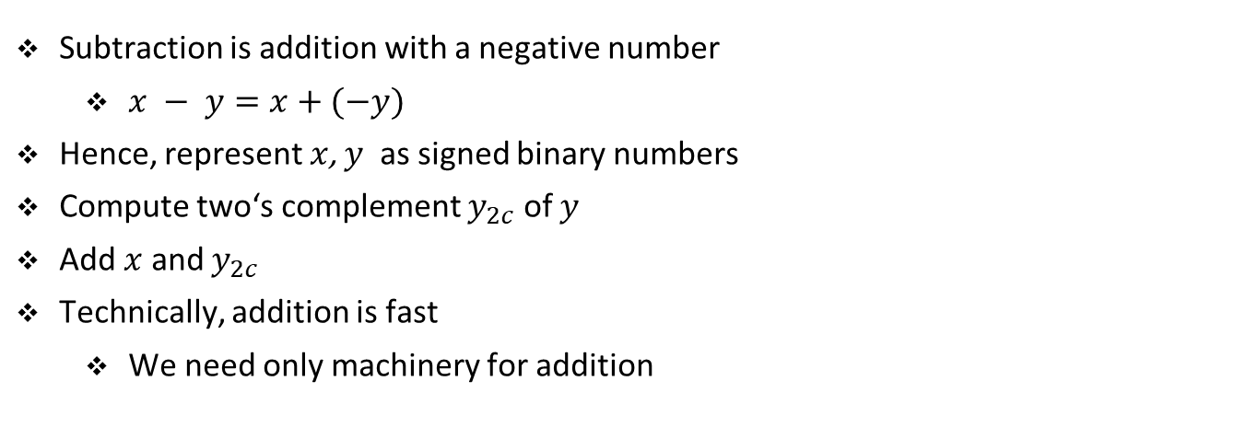
Subtraction of binary numbers
Subtraction is addition with a negative number
$x − y=x+(−y)$
Hence, represent $x$, $y$ as signed binary numbers
Compute two‘s complement $y_{2c}$ of $y$
Add $x$ and $y_{2c}$
Technically, addition is fast
We need only machinery for addition

Slide 52
Exercise

Slide 53
Student task
Task 4: Find the two‘s complements of these numbers using one byte.
25
67
200
133
 |  |  |  |  |  |  |  |  | = x
 |  |  |  |  |  |  |  |  | Ones‘ complement of x
 |  |  |  |  |  |  |  |  | +1
 |  |  |  |  |  |  |  |  | Carry
 |  |  |  |  |  |  |  |  | Result = ?

Slide 54
Student task
Task 5: Subtract these numbers using one signed byte.
25 and 12
67 and 33
110 and 101
 |  |  |  |  |  |  |  |  | = x
 |  |  |  |  |  |  |  |  | Ones‘ complement of x
 |  |  |  |  |  |  |  |  | +1
 |  |  |  |  |  |  |  |  | Carry
 |  |  |  |  |  |  |  |  | Result = ?
x + (-y) = ?
 | Sign | 64 | 32 | 16 | 8 | 4 | 2 | 1 |  | Position value
+ |  |  |  |  |  |  |  |  |  | First number
 |  |  |  |  |  |  |  |  |  | Second number
c |  |  |  |  |  |  |  |  |  | Carry
= |  |  |  |  |  |  |  |  |  | Result = ?

Slide 55
Multiplication and division of binary numbers
Multiplication is typically carried out by repeated addition
There are more efficient algorithms for multiplication
These include shifting bits to the left
Division is typically carries out by repeated subtraction
More efficient algorithms exist

Slide 56
Exercise

Slide 57
Student task
Task 6: Recollect the rules for binary addition. Think of x and y as Boolean variables and of c and s as Boolean functions c(x, y) and s(x, y). Represent c(x, y) and s(x, y) with a table. Find Boolean expressions that represent c(x, y) and s(x, y). Simplify these expressions to only use Boolean complement, sum, and product.
Case 1
x=0
y=0
c=0
s=0
Case 2
x=1
y=0
c=0
s=1
Case 3
x=0
y=1
c=0
s=1
Case 4
x=1
y=1
c=1
s=0

